Slide 1
Stock Predictions
vs
Actual Price
Group 1 : August 6th 2024
William Aromando
Dan Becker
Vivin Rajagopalan
Anthony Nguyễn

Slide 2


Project Intro
Searching for data
Searched on Kaggle for datasets to work with, we knew we wanted to work in stocks or finances. (https://www.kaggle.com/)
Created a repository and added each member as a collaborator
Found Google stock and Apple stock data on kaggle and imported it into our repo to review the data
Decided to pull predictions from the Google and Apple datasets
Filtered the data to exclude already known data to complete predictions on
Compared prediction data to the known data to visualize prediction accuracy

Slide 3
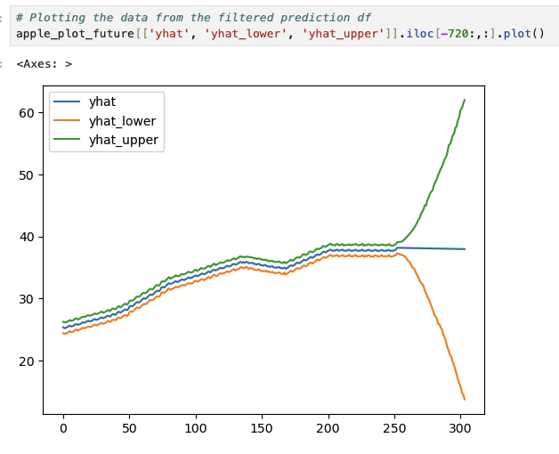
Apple Stock Predictions
2016 - 2017 year data
import Apple_stock_history.csv
Checked/cleaned the data
filtered data to necessary columns
Placed filtered data frame into a Prophet model for predictions
Plotted predictions

Slide 4
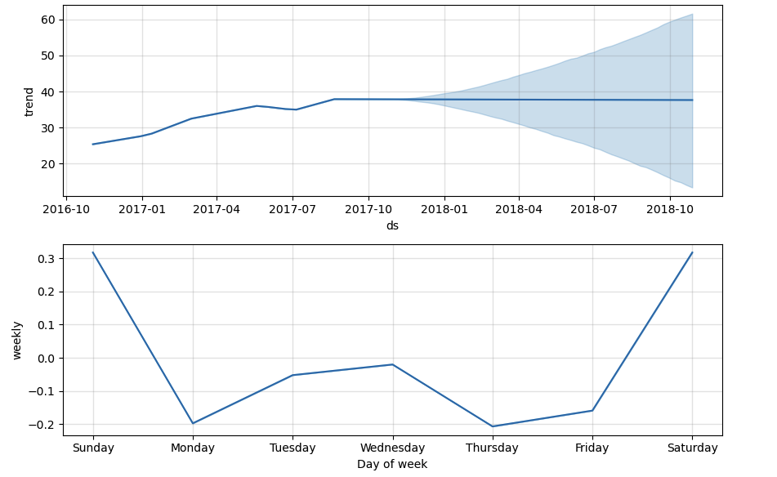
Plotted data in different format by year and day of week for possible trend spotting

Slide 5
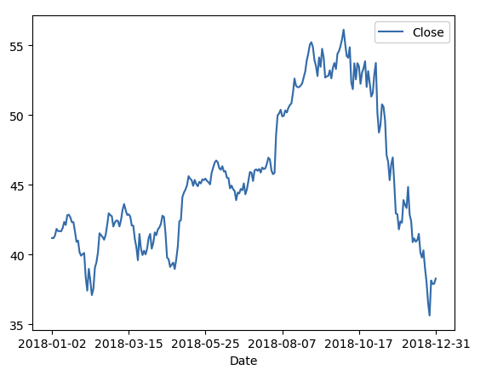
Actual Apple Stock
Filtered 2018 Data
Filtered the original data frame to only the year 2018 for actual stock prices Plotted the data by year to view
Prepared this data to be compared to the predicted data for 2018

Slide 6
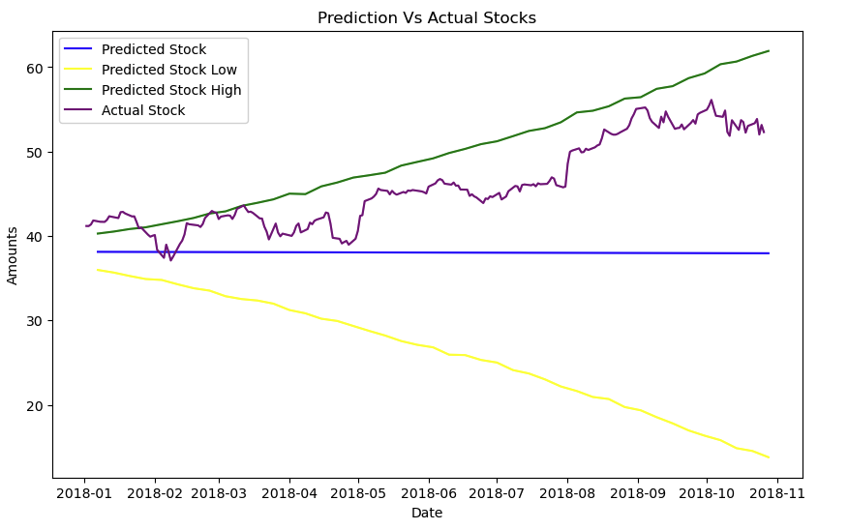
Actual vs Prediction
Apple Prediction accuracy
Plotted the Apple stock predictions and the actual stock price from 2018
Our figure showed that in this instance the prediction model was accurate

Slide 7
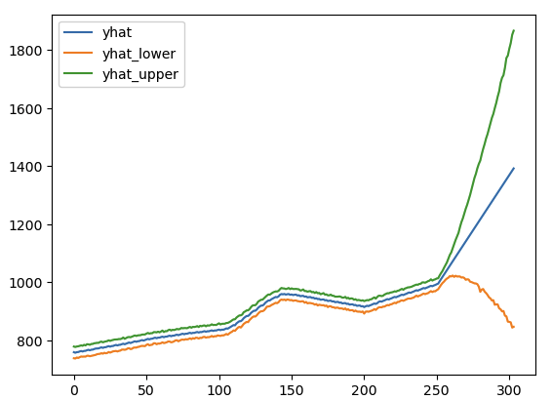
Google Stock Predictions
2016 - 2017 Data
import GOOG-year.csv
Checked/cleaned the data
filtered data to necessary columns
Placed filtered data frame into a Prophet model for predictions
Plotted predictions

Slide 8
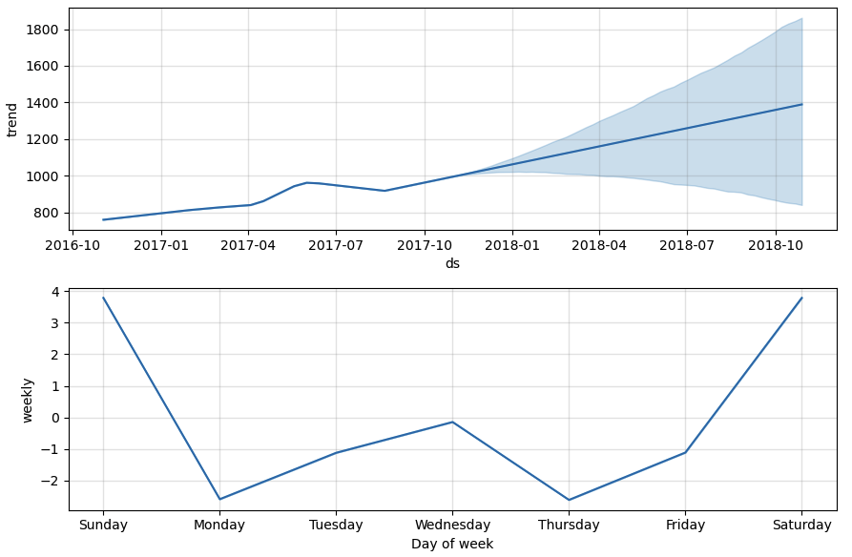

Slide 9
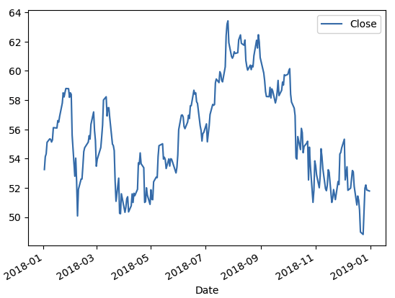
Actual Google Stock
Filtered the original data frame to only the year 2018 for actual stock prices. Plotted the data by year for viewing
Prepared this data to be compared to the predicted data for 2018

Slide 10
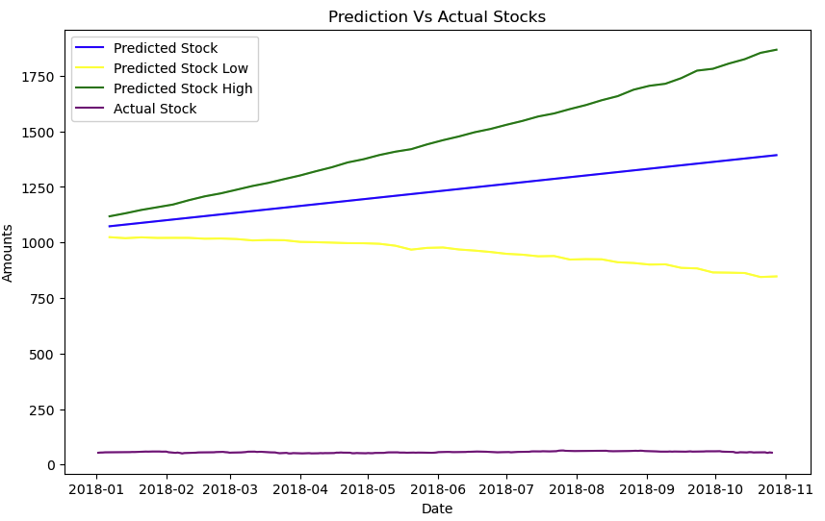
Actual vs Prediction
Google prediction accuracy
Plotted the Google stock predictions and the actual stock price from 2018
Our figure showed that in this instance the prediction model was not accurate. After some searching online we found that Google had split their stocks in 2014 2:1 and 20:1 in 2022. This was the reason the predictions were inaccurate.

Slide 11
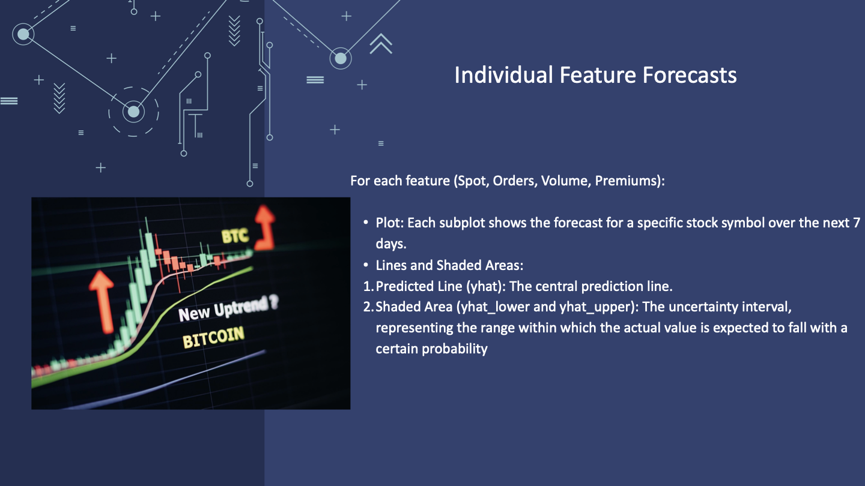

Slide 12
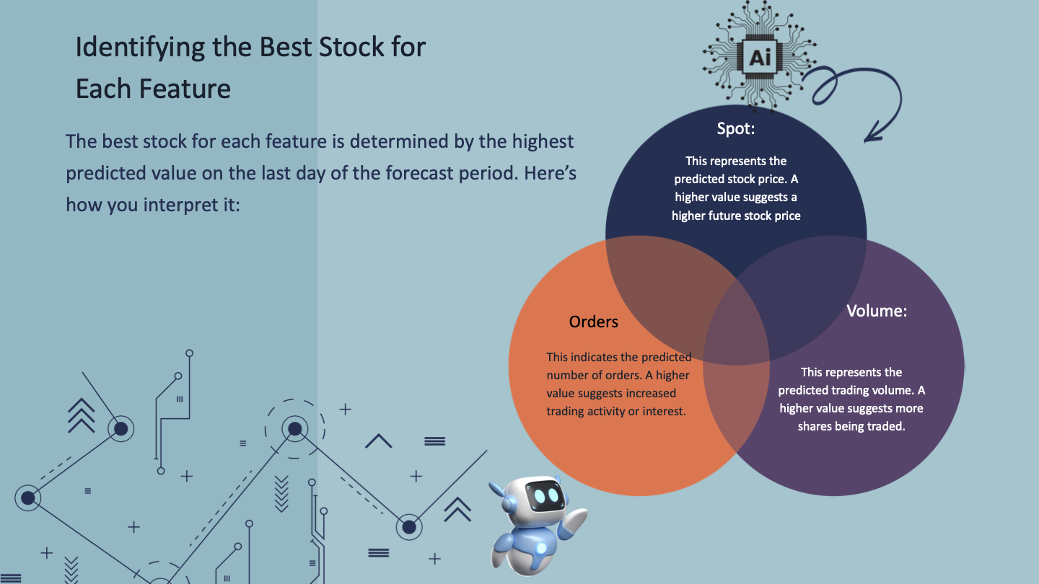

Slide 13
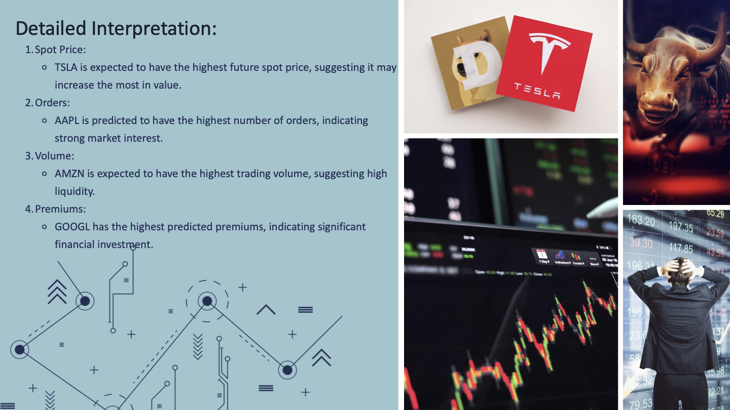

Slide 14
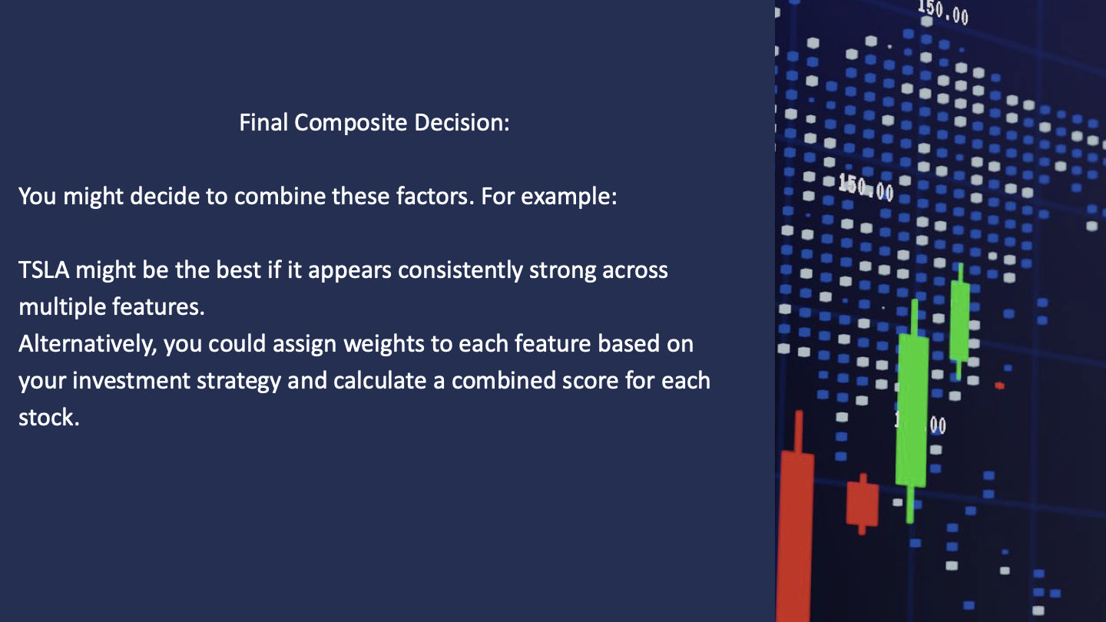

Slide 15


Slide 16
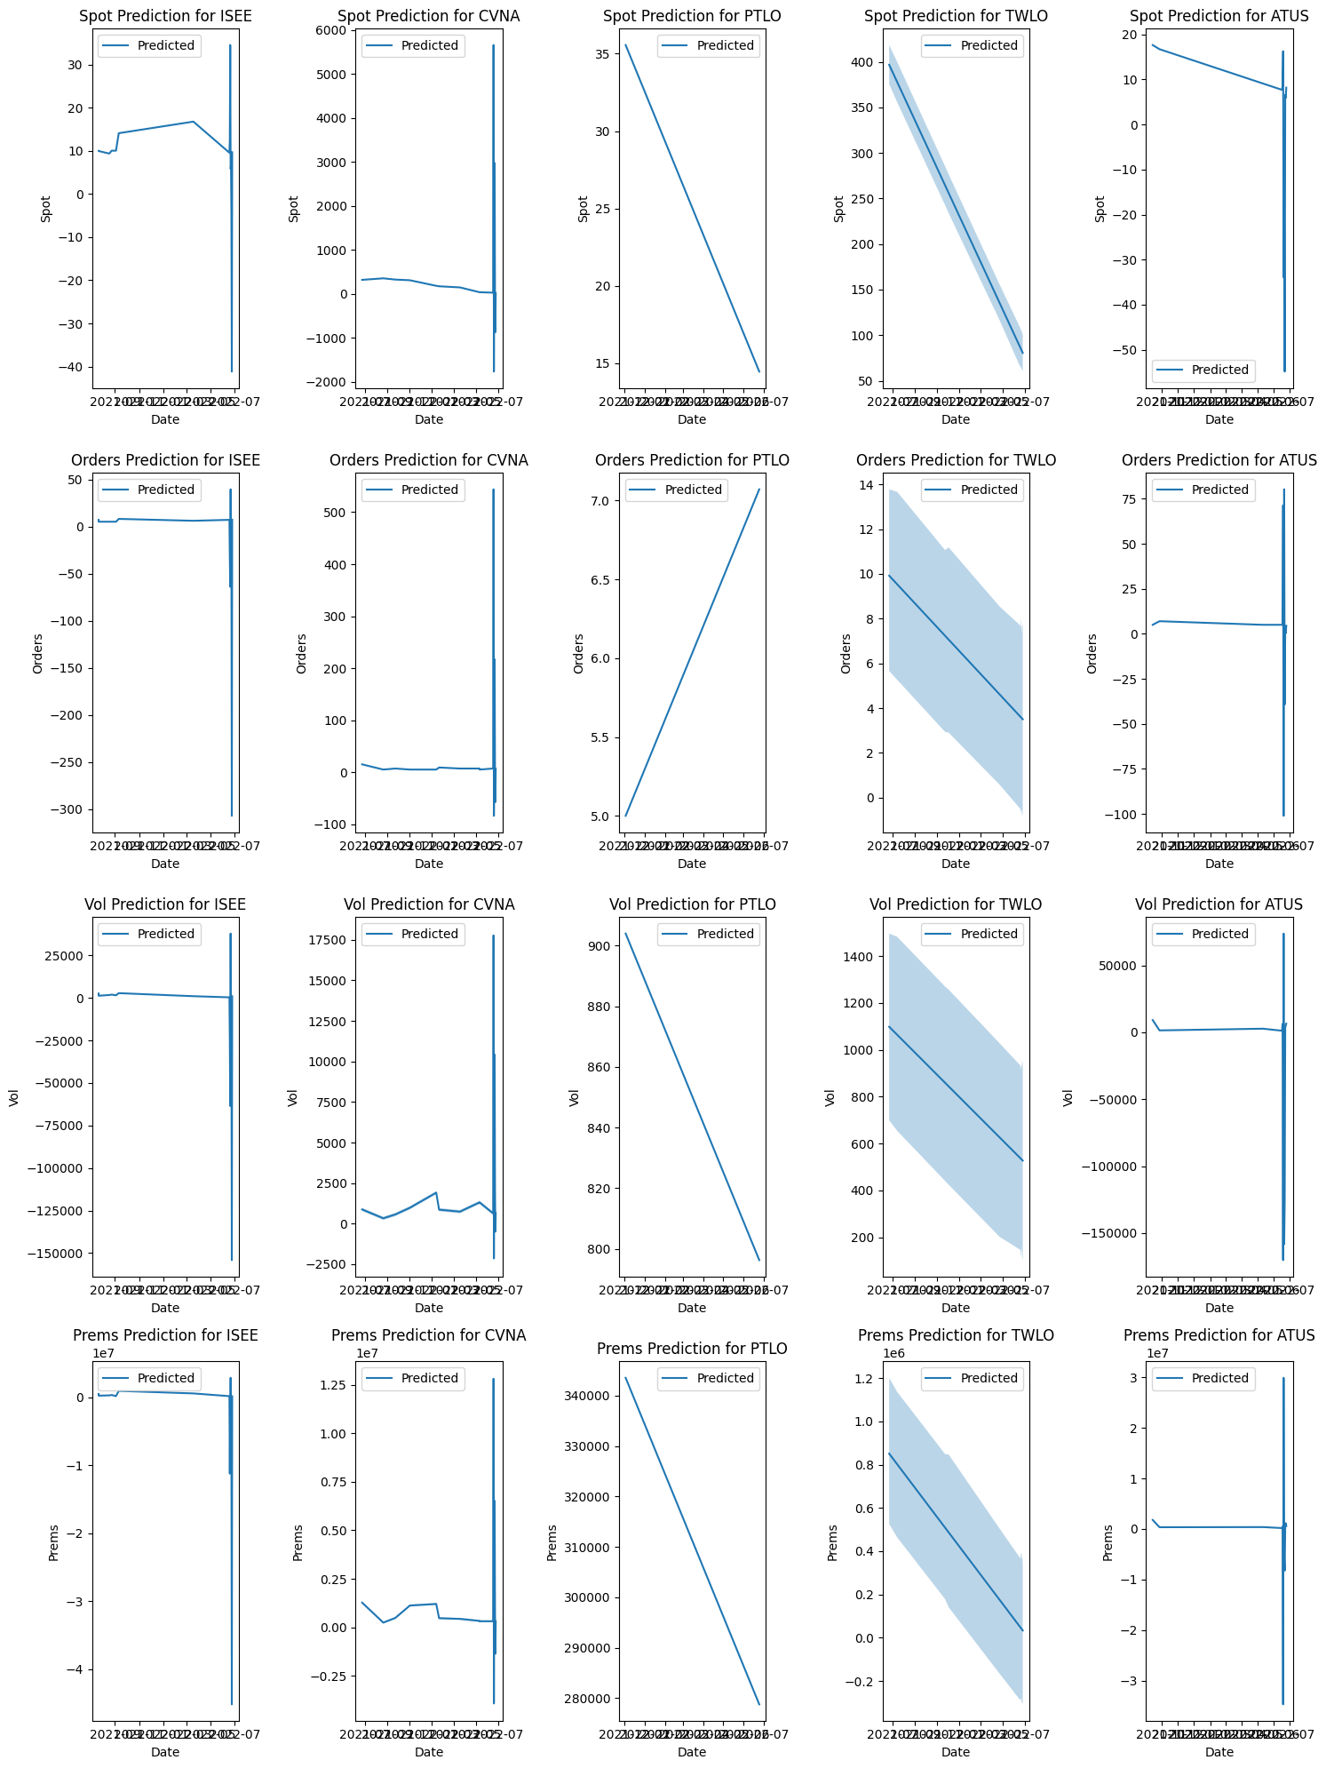

Slide 17
Project Recap
Checking the accuracy of Prophet Analysis
We began this project searching for stock data and what we should do with the data. We came to the conclusion to check and clean the data and then include the Prophet model to predict future stock prices.
After playing with the data and receiving the future stock predictions we decided to compare them to the actual prices in the “real world” datasets. We imported the “real world” data and filtered the datasets to the predicted dates from our Prophet model.
After completing this we plotted all the data and compared predictions against the “real world” data to see the accuracy of the Prophet model.
Conclusion:
After completing our project we have found that the Prophet model is accurate in its predictions, except that it does not account for stock splits.

